Slide 1
PROJECT REPORT ON
Image Processing Algorithm for Model Smart Home
By:-
Anish Agarwal 070/10
Vivek Kumar 555/10
Yogesh Kumar Gupta 561/10
Project mentor - Prof. Amit Prakash

Slide 2
What is Gesture Control and Smart Devices
Gesture controlled smart devices are meant to simplify lives of user by understanding their gestures and accordingly responding to them.
Advantages
Beneficial to differently-abled people.
Integrates response experience with natural human motion.
Comfort of use.

Slide 3
Understanding Image Processing
Image processing involves capturing, storing, and processing images to extract useful information and use this for human needs.
Applications of Image Processing
Face recognition
Automated robotic systems
Systems that respond to human gestures
Image enhancement and modification
Pattern recognition and traffic sign recognition

Slide 4
Objective of the Project
Motivation for the Project
Interaction with media and information without any physical restrictions
learning for students could be made easier – replace complex commands
Hand gestures enable humans to communicate naturally
Gestures can be used to recognize and interpret sign language
The objective of this work is to develop a simple algorithm that can perform a basic human-computer interaction in which a user can control a media player, an image viewer, and a slide show using gestures.
Also, to develop a GUI application that can open an image and make some basic enhancements to it.

Slide 5
Tools being used
MATLAB: Fourth generation computational software that has a wide array of toolboxes including image processing toolbox.
Arduino Open source Development Platform:
Uses on-board ATmega microcontrollers, easily interfaces with MATLAB using Arduino Toolbox. Will be used to develop prototypes of gesture control mechanisms.
Camera for Input

Slide 6
Learning topics for the project
Operating Arduino after interfacing it with MATLAB using Arduino Toolbox.
Interfacing a Media Player with MATLAB and controlling it – basic steps like play/pause, next/previous.
Likewise interfacing other applications.
Motion detection algorithms in MATLAB.
Developing GUI in MATLAB and adding functionality to it.
Success rates for correct gesture detection.

Slide 7
Fundamentals of Images
Images are functions that can be expressed as the product of illumination and reflectance
f(x, y) = i(x,y) * r(x,y)
Illumination is the amount of light that falls on object and reflectance is a measure of amount of light reflected.
Images can be of various types as Binary Images, RGB images, YCbCr images, HSI images, and CMYK images.

Slide 8
Some tasks in Image Processing
Acquire
Process
Segment
Recognize
Mean filtering
Median Filtering
Histogram Equalization
Motion Detection
Image Sharpening
Edge Detection
…and several other tasks

Slide 9
Basic functions in Image Processing
>>i=imread('abc.jpg'); %ABC in any format, such as jpg, gif etc
>>imshow(i); %show the image
>>j=rgb2gray(i); % j is grayscale of i
>>imhist(j); %see the histogram, i should be 2- dimensional.
>>imwrite( j, 'New.jpg', 'jpg'); %save to disk the grayscale image
>>i=imadjust(i); %improves contrast
>>i=immultiply(i, 2); %lightens image, enter value less than 1 to darken the image, e.g. 0.5
>>k=imcomplement(i); %negative of image, accepts all image formats
>>l=im2bw(k); %converts to binary image
>>m=imfinfo('abc.jpg'); %displays all the information, m is a structure

Slide 10
Capturing Live Video feed
v = videoinput('winvideo',2, 'YUY2_640x480');
start(v);
while 1
I = getsnapshot(v);
% other lines of code
%processing
%segmentation and feature extraction
%device control
end

Slide 11
Important functions - colorseg
function colorseg for performing segmentation in colour images
the function uses a mask to segment the region of interest from the rest of image
Input taken is the image, and the mask
code written in MATLAB

Slide 12
Important functions – mahalanobis and roipoly
function mahalanobis for generating the mask for segmentation
roipoly is used to make an estimate of the desired region of interest
code written in MATLAB
other alternative is to use Euclidean, but results are far more superior in the previous case

Slide 13
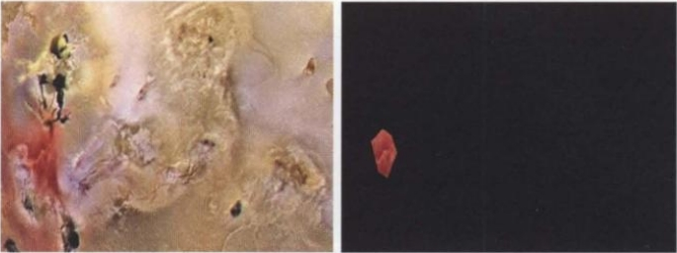
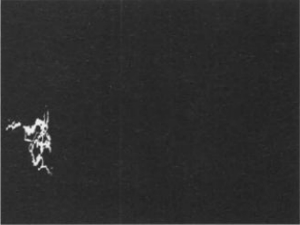

Fig. The image of Jupiter’s moon and ROI extracted using roipoly
Fig. Segmentation results obtained using (i) Euclidean and (ii) Mahalanobis

Slide 14
Important functions – dilation and erosion
‘imdilate’ is an operation that "grows" or "thickens" objects in an image
extent of this thickening is controlled by a shape referred to as a structuring element
‘imerode’ is an operation that "shrinks" or "thins" objects in a binary image
these functions are used to remove holes in binary images

Slide 15
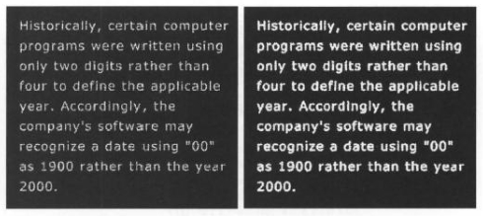
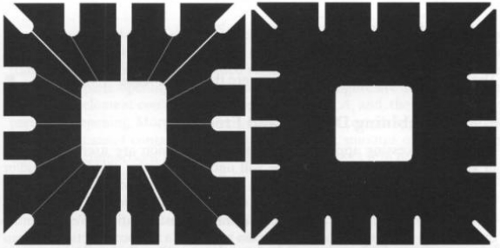
Fig. Enhancing text readability using dilation
Fig. Effect of erosion on the thin connecting wires

Slide 16
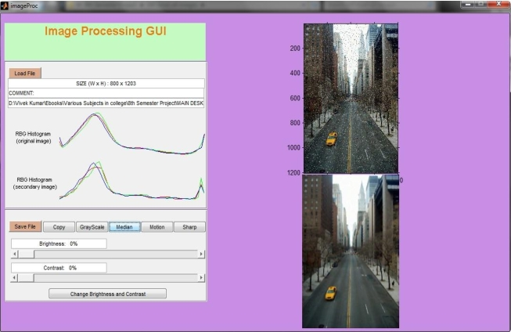
Application I – Image Processing GUI
Functions performed: Copy, Median filtering, Grayscale conversion, Sharpening, Brightness and Contrast Enhancement
Objective is to show some basic image processing operations using a GUI

Slide 17
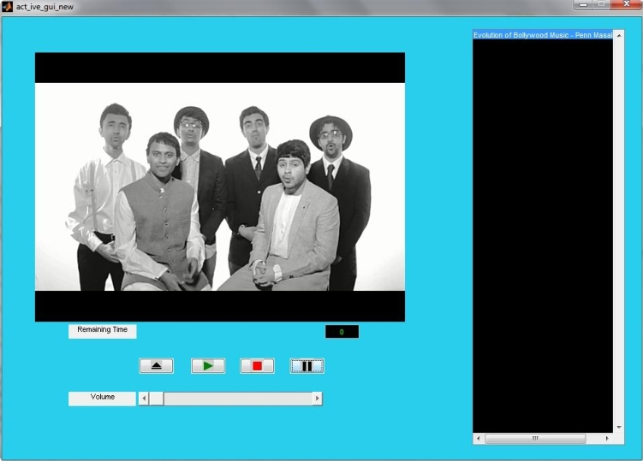
Application II – Media Player Control
Functions performed: Open, Pause, Play, Stop, Volume Control, Playback Control
Interfacing with MATLAB via Media Player ActiveX Library

Slide 18
Other Applications
Image Viewer – to view images, move to next or previous images. Image Viewer is MATLAB’s built in figure display window.
Control of slideshow in PowerPoint – Move to next and previous slide, exit presentation, save presentation.
Interfaces with MATLAB via PowerPoint Object Reference Model
Control of room lights, fans, TV, or any other thing – turning them ON/OFF

Slide 19
Results – I – Test conditions
Samples were taken under three different light conditions – low light, conditions, natural light conditions and artificial light conditions
Camera was kept at a distance ranging from 30cm to 50cm.
Three users tested the models.
Camera model - in-built 3.1 MP camera in Samsung GT-S6102 with Android OS, image resolution 320 x 240
Using colour bands worn on fingers and without using colour bands worn on fingers

Slide 20
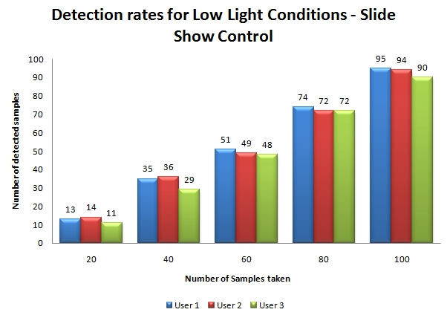
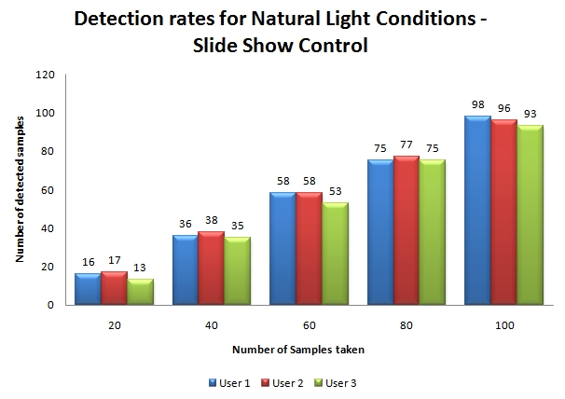
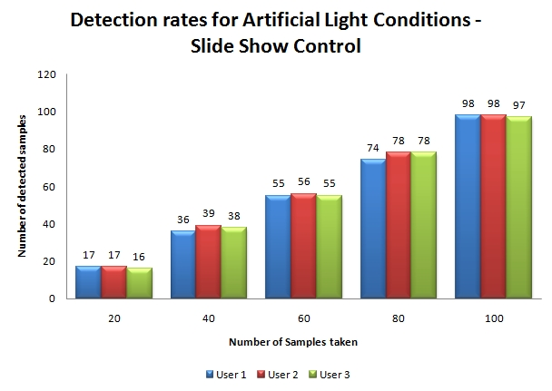
Results – II – With colour bands
Number of samples taken was increased successively from 20 to 100 in steps of 20.
The results are shown for low
light conditions, natural light
conditions and artificial light
conditions

Slide 21
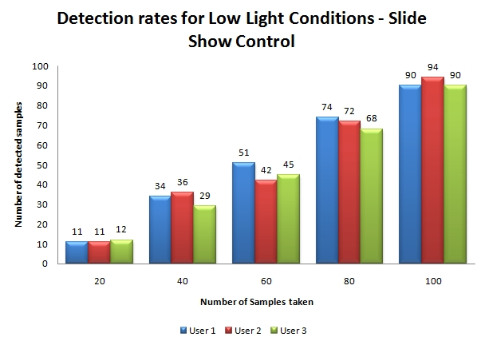
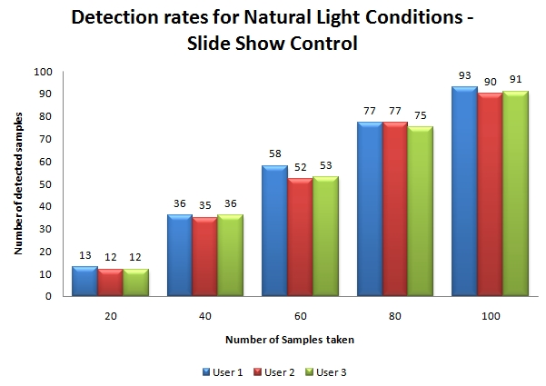
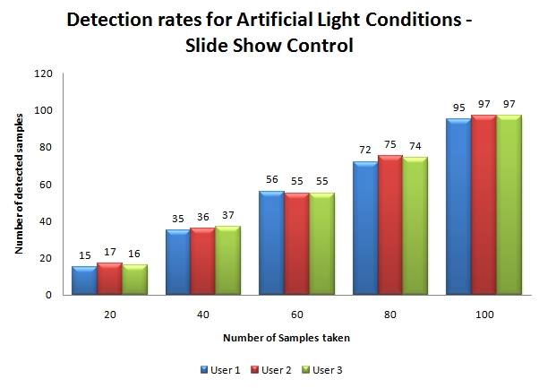
Results – III – Without colour bands
Number of samples taken was increased successively from 20 to 100 in steps of 20.
The results are shown for low
light conditions, natural light
conditions and artificial light
conditions

Slide 22
Conclusion and Future Work
Accuracy rates in excess of 80% were obtained by the algorithm
Slightly higher detection rates in case of using colour bands
Project on development of gesture-controlled appliances proved to be a great learning experience
Future motive – Incorporate a self learning system that eliminates the need to train the algorithm in recognizing the images.
Other possible development work – Explore possibilities to use image processing capabilities in detection of surface deformities, sign languages for differently-abled, medical imaging and remote sensing.

Slide 23
ACKNOWLEDGEMENTS
Professor and Head(Dep’t of ECE) – Prof.(Dr.) S.N. Singh
Project Mentor – Prof. Amit Prakash (Dep’t of ECE)
Other respected faculty of Dep’t of ECE
Vivek Kumar (Dep’t of EEE) – UG student
Sujit Kumar Dutta (Dep’t of EEE) – UG student
Alok Kumar Jha (Dep’t of ECE) – UG student
Friends, family and fraternity
THANK YOU

